Slide 1





heart disease
DATA MINING
Studio Shodwe
Students name:
Danah AlDhowaihy 445202207
Reem Almaskati 445201439
Ghadah alhamdan 445202148
Jana Alshghatrh 445200278

Slide 2

WHAT IS OUR PROBLEM?
WHY IS IT IMPORTANT?
Heart disease is often not diagnosed until it reaches an advanced stage, which leads to serious complications and, in many cases, preventable deaths.
Early detection can save lives. By analyzing key health indicators, this project uses data analytics to identify risk patterns sooner and support faster, more effective diagnosis and treatment.

Slide 3


Contents:
Data Representation
Data Preprocessing
Classification
Clustring

Slide 4
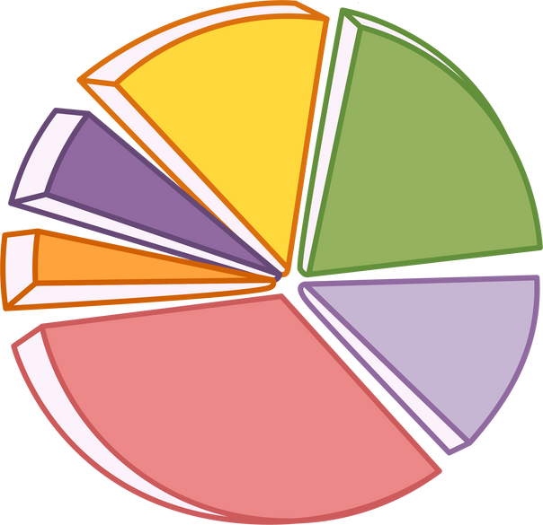

DATAset OVERVIEW
The dataset contains 918 patient records with 12 clinical and diagnostic features.
Target Variable: HeartDisease
- `1` = Has Heart Disease
- `0` = No Heart Disease
Feature Categories:
AGE
Sex
ChestPainType
RestingBP
Cholesterol
FastingBS
MaxHR
ExerciseAngina
Oldpeak
ST_Slope
HeartDisease (Target)
RestingECG

Slide 5
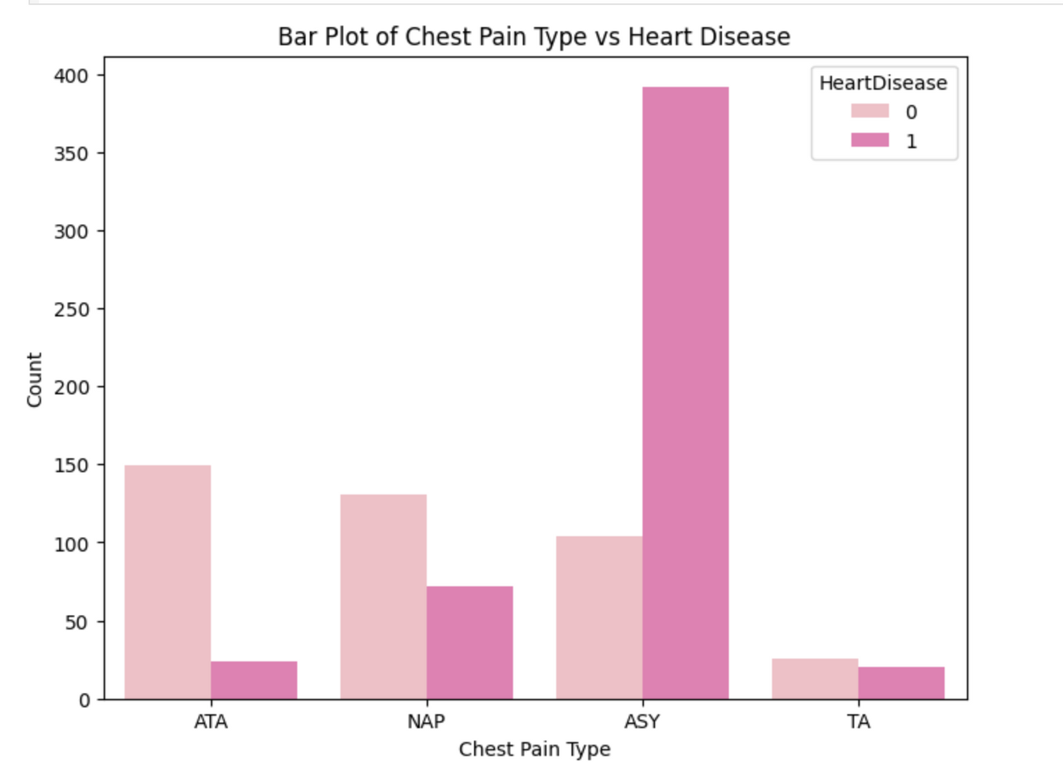

Slide 6
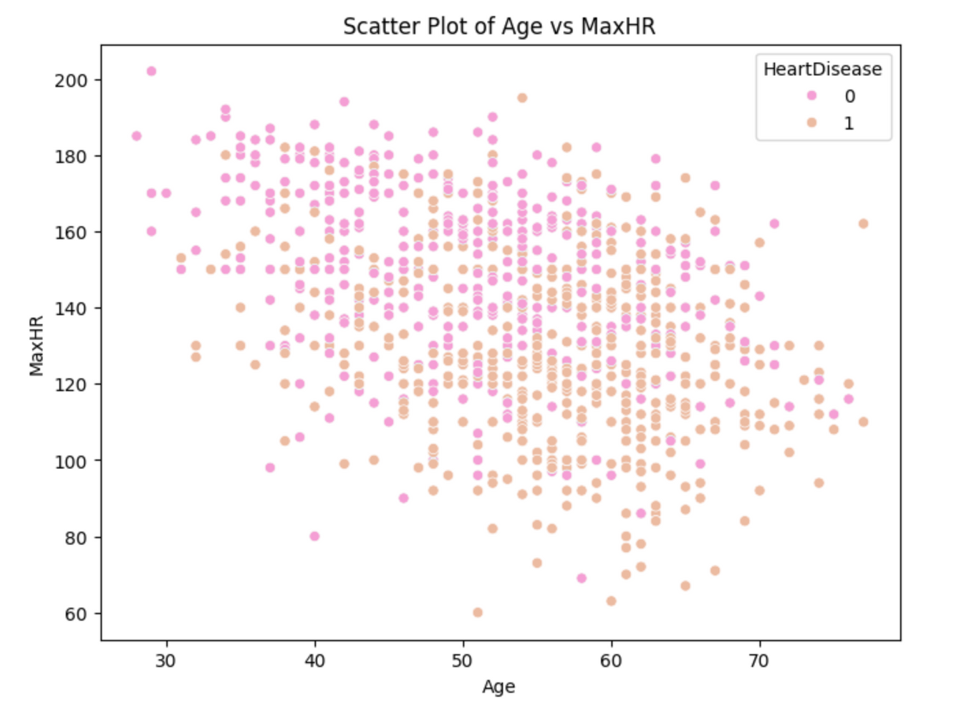

Slide 7


Data
preprocessing
Learn More
Data Cleaning
Missing values
outliers
Data Transmission
Encoding
Normalization
Discretization
Data Reduction
Feature Selection

Slide 8

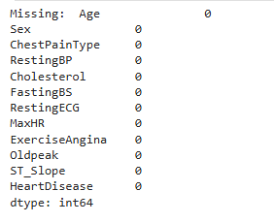
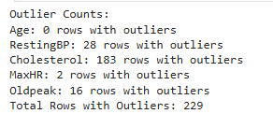

Data cleaning
Missing values
Outliers
We checked the dataset for missing or abnormal values to ensure data integrity.
To maintain the quality and reliability of the model, we examined the dataset for outliers using statistical methods.

Slide 9
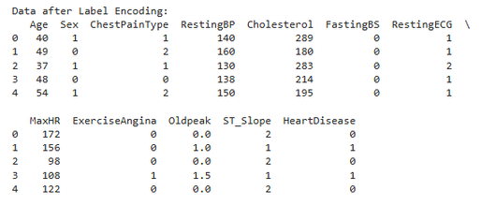
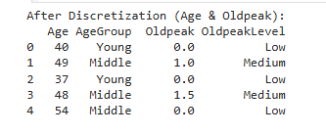
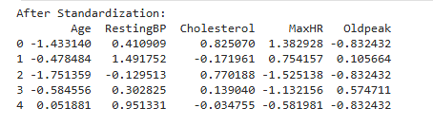
DATA TRABSFORMATION
Discretization
Encoding
Normalization
We created meaningful groups from continuous features—such as age ranges—to simplify interpretation and reveal clearer patterns in relation to heart disease.
We converted all categorical attributes into numerical values using label encoding.
We applied Min-Max Scaling to normalize the numerical features and place all values within a similar range.

Slide 10


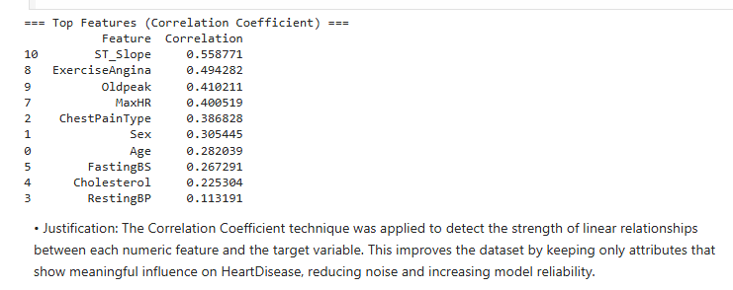

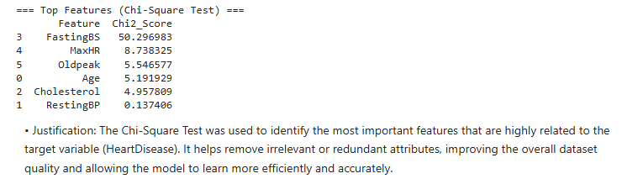
DATA REDUCTION
Feature Selection:
Correlation Coefficient
Chi-Square Test

Slide 11


Clustering
It is an unsupervised learning approach that groups the data into clusters with high similarity within each group and clear dissimilarity between groups, after removing the “heart disease” class label.
Learn More

Slide 12
preparing the data for clustering
Our dataset contained several categorical attributes that needed to be transformed into numerical values before applying clustering. To achieve this, we used ordered encoding for features such as Age, RestingBP, Cholesterol, MaxHR, and Oldpeak.

Slide 13
Clustering Methods Used:
Partitioning approach: K-means
We use K-means because it is simple, fast, and effective for splitting the data into clear groups. It also handles larger datasets efficiently and is easier to apply and understand compared to other clustering methods.

Slide 14
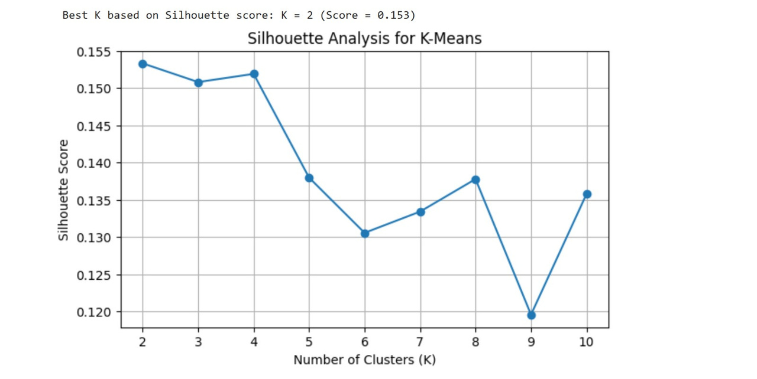
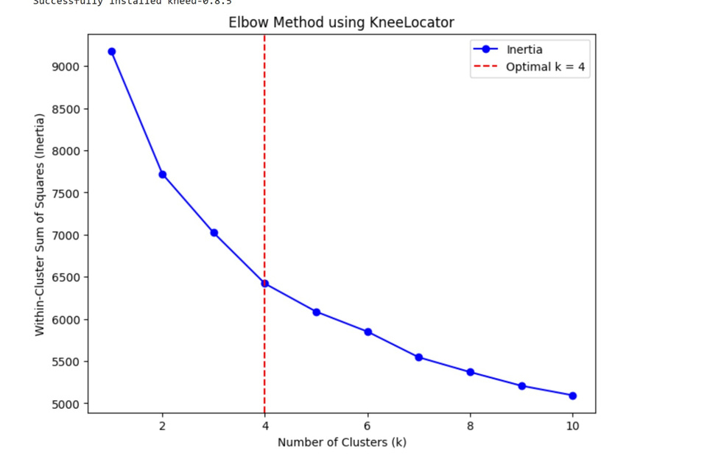
Optimal number of clusters

Slide 15
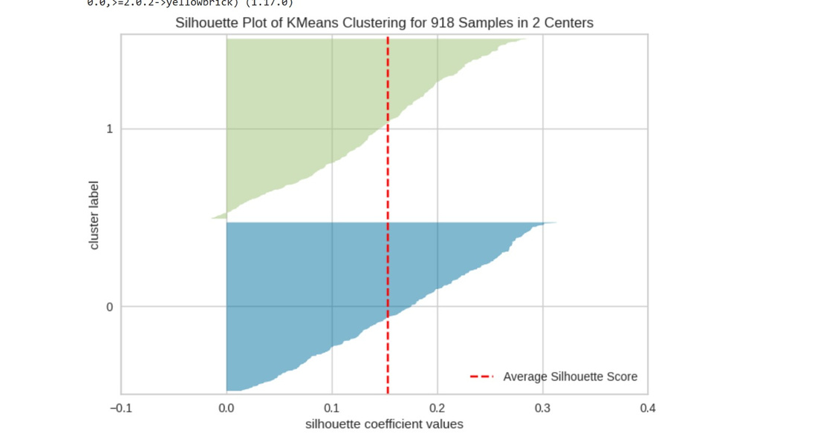
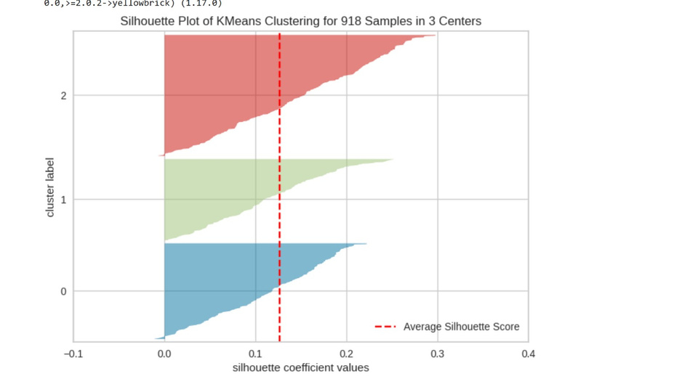
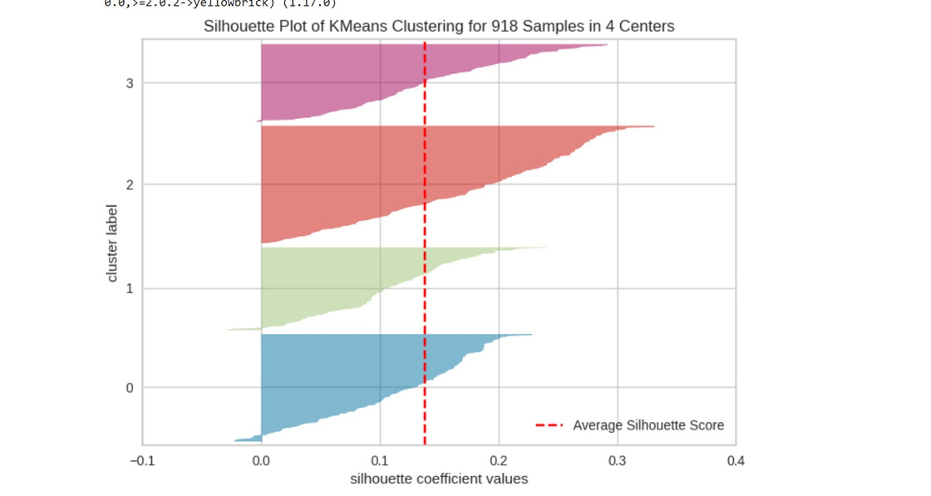
results
Number of clusters
K=2
K=3
K=4
7721.17
7022.67
WSS
6419.65
0.1533
0.1519
Silhouette Score
0.1508
0.186

Slide 16

Classification

Slide 17

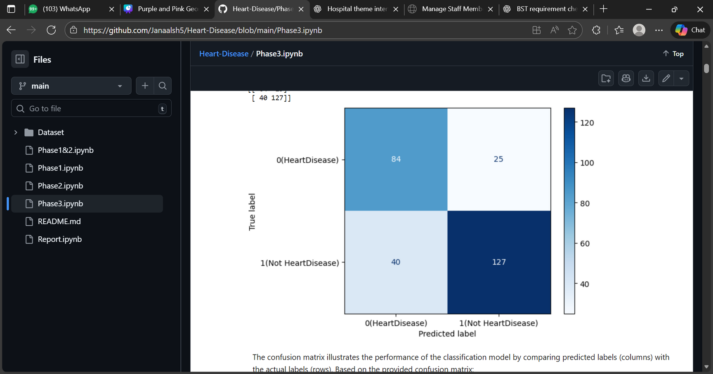
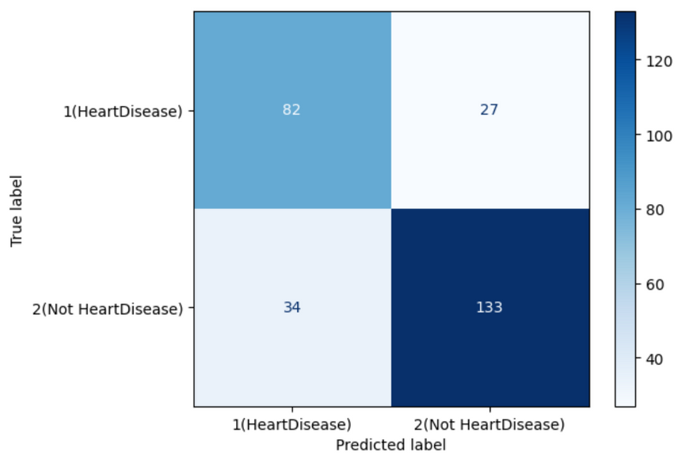
Confusion matrix
Information gain
Gain index

Slide 18
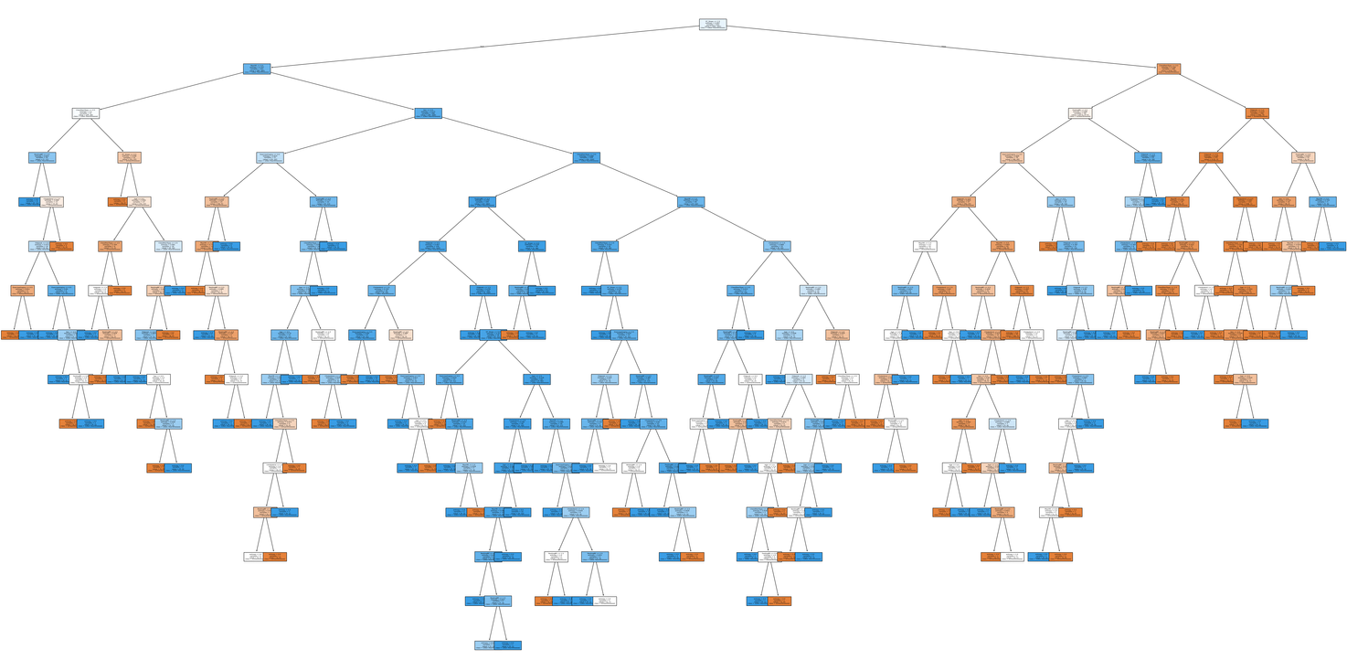
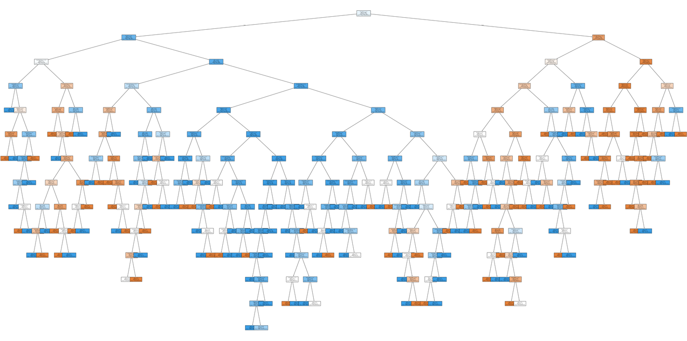
Decision tree

Slide 19



Comparison Between Different
Partition Using Information Gain
70% Training data, 30% Test data.
60% Training data, 40% Test data.
80% Training data, 20% Test data.
Accuracy
76.44%
Accuracy
77.44%
Accuracy
80.97%
Error rate
23.55%
Error rate
22.55%
Error rate
19.02%
Sensitivity
76.04%
Sensitivity
76.27%
Sensitivity
81.81%
Specificity
77.06%
Specificity
79.08%
Specificity
79.72%
Precision
83.55%
Precision
83.67%
Precision
85.71%

Slide 20
Comparison Between Different
Partition Using Gain Index
70% Training data, 30% Test data.
60% Training data, 40% Test data.
80% Training data, 20% Test data.
Accuracy
77.89%
Accuracy
76.08%
Accuracy
80.43%
Error rate
22.1%
Error rate
23.91%
Error rate
19.56%
Sensitivity
79.64%
Sensitivity
74.88%
Sensitivity
80%
Specificity
75.22%
Specificity
77.77%
Specificity
81.08%
Precision
83.12%
Precision
82.56%
Precision
86.27%

Slide 21

Information Gain vs Gini Index
Accuracy
Sensitivity
Information Gain is slightly higher (81%) than Gini (80.43%),
Information Gain is higher (81.82% vs 80%)
Error Rate
Specificity
Gini Index is higher (81.08% vs 79.73%)
Information Gain has a slightly lower error rate(19.02%vs19.56%).
Precision
Gini has higher precision (86.27% vs 85.71%)

Slide 22

Partition Comparison
60/40
70/30
80/20
Lowest performance across most metrics.
Accuracy, sensitivity, and precision dropped noticeably.
Shows that smaller training data negatively affects model learning.
Good overall performance.
Slightly behind the 80/20 split.
Balanced accuracy, sensitivity, and precision for both Gini and Information Gain.
Best performance across all evaluation metrics.
Highest accuracy, sensitivity, and precision.
Clear benefits of using a larger training dataset.

Slide 23
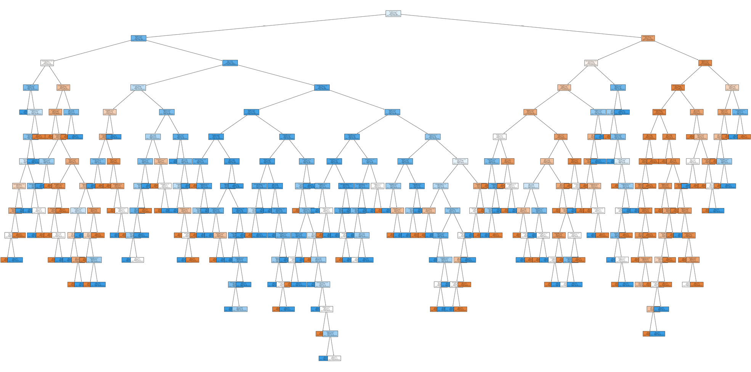
model Tree

Slide 24
Final conclusion
Our classification results showed that the 80/20 split achieved the best performance with 81.52% accuracy. Information Gain was better at detecting positive cases, while Gini Index reduced false positives. Overall, decision trees proved reliable for assessing heart-disease risk.

Slide 25
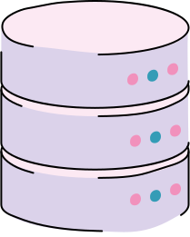
thank you
For Your Attention

